Slide 1
The Big Traffic® Difference
Mobile Billboards contain 400 Square Feet of Advertising with advertising on the sides, front and back of the Mobile Billboard.
We would like to have a Mobile Billboard in Boulder City for every event. Jill Lagan and Michael Spielman will review the events that allow for the most response for the advertisers
We chose events because this will get you a much better response because more people will see the mobile billboard than usual.
We will park the Mobile Billboard in Boulder City (With Chamber’s permission) where everyone can see the Mobile Billboard.
We need 4 clients to commit to advertising their services on the mobile. On each side of the mobile there will be 2 clients to split the vinyl to promote their services.
The initial cost of printing the vinyl will be $1,000 split 4 ways, $250 per client. This is a one time cost.
The price per event is $110 per client. This will promote your business for 10 hours during the event.
We will allow one client per industry. For example if an insurance agent is on the mobile we will not have another insurance agent on it.

Slide 2
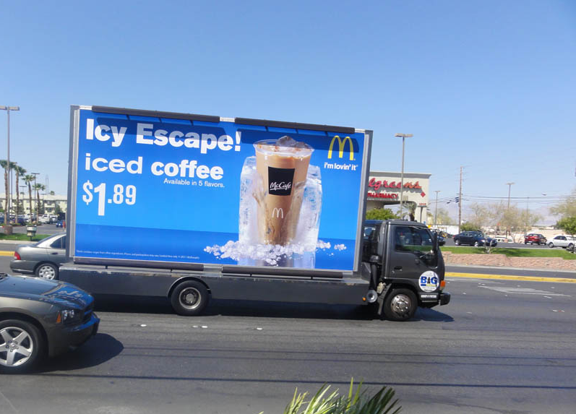
Our Clients - McDonalds

Slide 3
Contact information:
Michael Spielman
Senior Account Executive
702.418.8820
Letizia Mass Media®
5460 Desert Point Drive
Las Vegas, NV 89118
702-777-2121

