Slide 1


Bruce Rauner, Governor Jeff Mays, Director
  Illinois Department of Employment Services:
  IMPROVING Services for You
  Marion Chamber of Commerce
  April 5, 2018
  Illinois Department of Employment Security

Slide 2

  Agency Context: What We Do
Administer Unemployment Insurance Trust Fund
  Collect largest employer tax in Illinois: $1.8 B
  Disburse roughly $2 billion in UI benefits
Provide Employment Services to Employers and job seekers
Provide Labor Market Information for the US Bureau of Labor Statistics

Slide 3
  Agency Context: IDES’ Eight Million Touches
6 million claimant touches per year through claims
    240,000 claims annually @17 week duration = 4.1M
    Recertification every two weeks = 1.9 M
2.2 million employer touches per year through tax
    Over 340,000 employer taxpayers
    120,000 file monthly – 1,440,000 touches
    Over 200,000 file quarterly - 800,000 touches
    100,000 Used to file by paper; now 45,000

Slide 4
  2015-2018 IDES
  STRATEGIC INITIATIVES
To improve our 8 million touches/services, the Governor approved these IDES initiatives in June 2015:
  Retire 5 legacy (1985-1998) tax systems
  Retire 6 legacy accounting/finance systems
  Replace 2 legacy fraud/collection systems and migrate the Benefit Charging System into IBIS
  Retire $963 Million in UI bonds issued by prior administration and reduce UI Taxes
  Improve employment/business services
  Improve UI Claimant Services

Slide 5
  Turnarounds completed
  From June 2015 – March 2018
  IDES went live with modern SAP Accounting system October 2016
  IDES went live with most modern UI Tax system in the country September 2017
  IDES retired $963 million in UI bonds in June 2017 and IDES Employer UI taxes have DROPPED $780 million since 2014
  IDES replaced antiquated phone technology and hired up at our call centers to reduce wait times and improve service. IDES has increased ES staff and training to reduce UI duration.
  MOSTLY COMPLETE: IDES will go live with new OATS anti-fraud system in July 2018 and retire our Benefit Charging System in March 2019

Slide 6
  Illinois Employers
  March 15, 2018
Total number of Employers in Illinois: 337,497
By Number of Employees:
0-24 workers: 292,497
25 to 499 workers: 42,748
500 or more; 2,366

Slide 7
  Agency Context: EMPLOYER UI TAX RATES
Tax Years | Fund Building % | Maximum % | Employer Taxes $$$=Billions
2018 | 0.525% | 6.400% | $1.820
2017 | 0.550 | 6.800 | $2.020
2016 | 0.550 | 7.200 | $2.200
2015 | 0.550 | 7.600 | $2.410
2014 | 0.550 | 8.000 | $2.600
2013 | 0.550 | 8.400 | $3.000

Slide 8
  OATS Anti-fraud Modernization 203,534 Improper claims STOPPED; $201 million SAVED
Since 2012, IDES has improved/implemented the following measures:
  Quarterly Crossmatch
  New Hire Crossmatch
  Social Security Crossmatch
  Inmate Crossmatch
  Secretary of State Crossmatch
  Monthly Crossmatch

Slide 9
  Hierarchy of Fraud Detection
Prevent fraud BEFORE payments are made
  SIDES NOTICE OF CLAIMS
  Secretary of State, Inmate, Social Security Crossmatches
  Registration in Illinois Job Link
Stop fraud AFTER payments have begun
  SIDES Notice of Claims, PLUS:
  New Hire and Monthly Crossmatches
  SIDES Earnings verification---JUNE 2018
Stop fraud AFTER payments have finished
  All of the above, PLUS:
    Comptroller’s Offset and IRS Taxpayer Offset Program
    Quarterly Crossmatch
NOTE: $384 Average Weekly Benefit Amount 2018; $627 Max w Dep
      $627

Slide 10
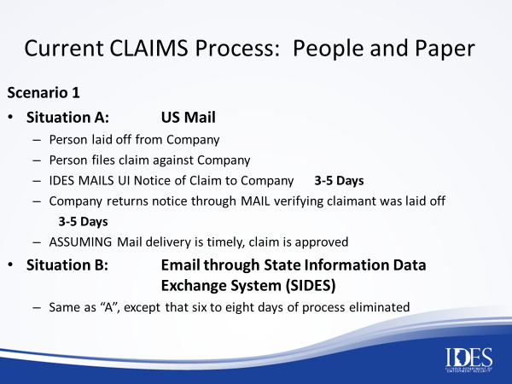

Slide 11
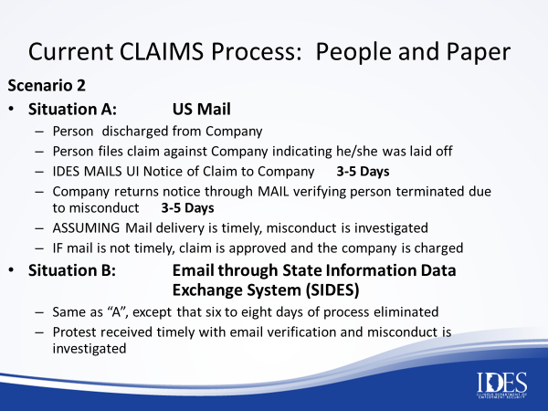

Slide 12
  WHAT’S NEXT? 2018-2019
  IDES STRATEGIC INITIATIVES
Launch SIDES Claims Notice/Protests
Re-Employment Initiative---improving the employer and job seeker connections
IBIS-MyTax Interface through BCS---the single missing link to a fully integrated tax and benefit system
Workforce Outcomes---How good are your training providers and state education systems?
Human Capital Management Systems Modernization

Slide 13
  STAY INFORMED
  MORE INFORMATION TO COME
Continue to watch the IDES website for additional information
  ides.illinois.gov
Call our Employer Hotline at 1-800-247-4984
With any questions, we are ready for you.

Slide 14
National Context
Illinois Unemployment Rates

Slide 15
  Statewide Context:
  Unemployment Projections

Slide 16
Statewide/Local Context
Employment Growth 2015-2018
Feb 15 Feb 17 Feb 18
Statewide 6,030,900 6,110,400 6,159,600
Williamson 29,800 30,400 30,000
Jackson 26,900 27,200 26,800

Slide 17
Local Context—Labor Force---Feb 2018
Williamson and Jackson Counties
Labor Force Employed Unemployed UI Claims
Williamson 31,516 30,045 1,471 640
UI Rate: 4.7%
Jackson 27,887 26,818 1,069 350
UI Rate: 3.8%

Slide 18
Local Context--Help Wanted--Feb 2018
Williamson and Jackson Counties
Help Wanted Adds Online
Williamson 490
Registered Nurses
Heavy and Tractor Trailer Truck Drivers
First line Supervisors Retail
Jackson 592
Heavy and Tractor Trailer Truck Drivers
First line Supervisors Retail
Registered Nurses

Slide 19

  QUESTIONS?

