Slide 1


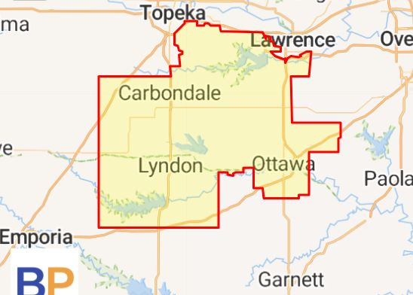
KANSAS STATE SENATE DISTRICT 3
RICK KLOOS,
R-BERRYTON

Slide 2
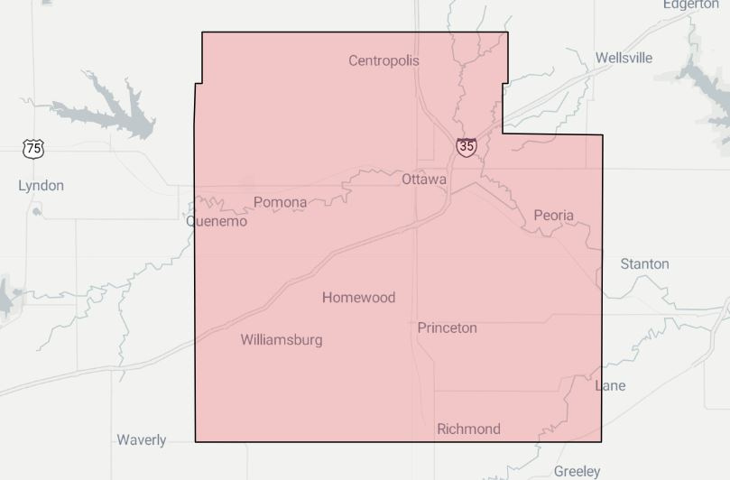
KANSAS HOUSE DISTRICT 59
REBECCA SCHMOE,
R-OTTAWA

Slide 3
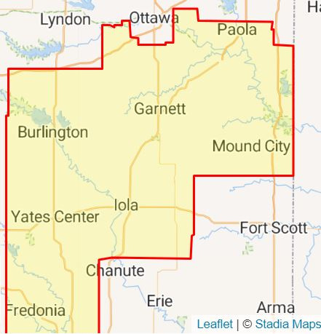
KANSAS STATE SENATE DISTRICT 12
CARYN TYSON,
R-PARKER

Slide 4
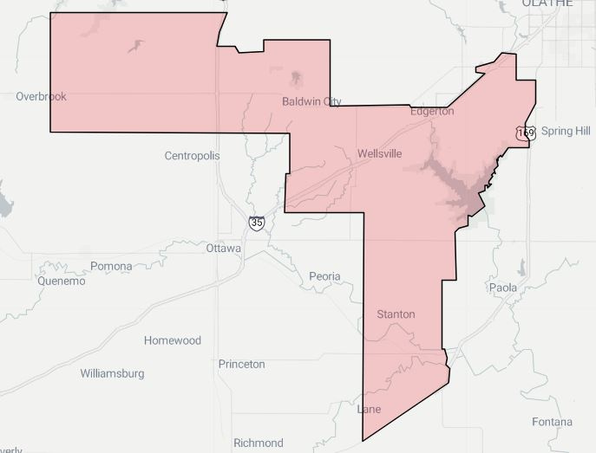
KANSAS HOUSE DISTRICT 5
CARRIE BARTH,
R-BALDWIN CITY

